Slide 1
This project is to practice the Spanish vowel sounds. First and second graders use the sounds at the beginning of the word. 3,4,5 use the sound in the middle or end of the word. See examples. Don’t use Spanish words.
Steps:
Cut out pictures that sounds “aahh, ehh, ihh, ohh, uhh” and glue them.
Write the words. Make sure to quote the vowels
Turn in a hard copy or take a picture and email it.

Slide 2
Vowel sounds
Aa “a”pple.
Ee “e”lephant
Ii “I”gloo
Oo “o”range
Uu “u”no.

Slide 3
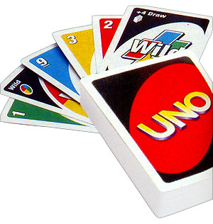

Slide 4
Nombre………………..Fecha…………….
Aa Aa
Ee Ee
Ii Ii
Oo Oo
Uu Uu

Slide 5
Vowel Sounds
Aa c“u”p
Ee p“e”n
Ii l“ea”ve
Oo “Au”gust
Uu f“oo”d

Slide 6
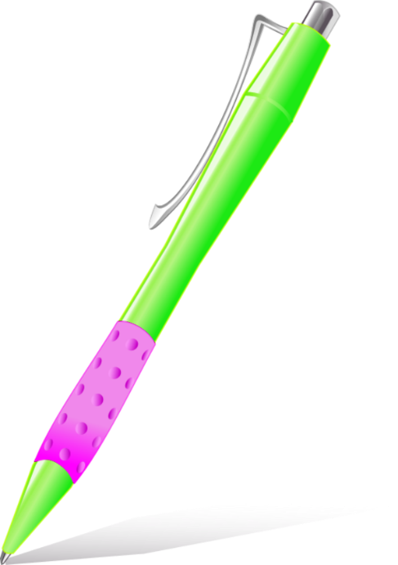
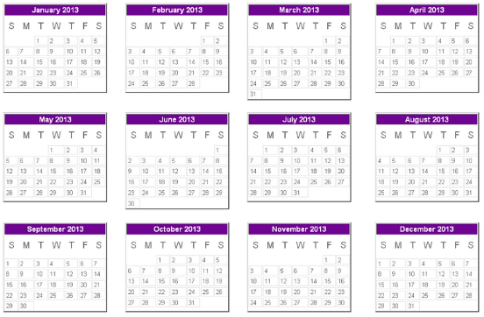
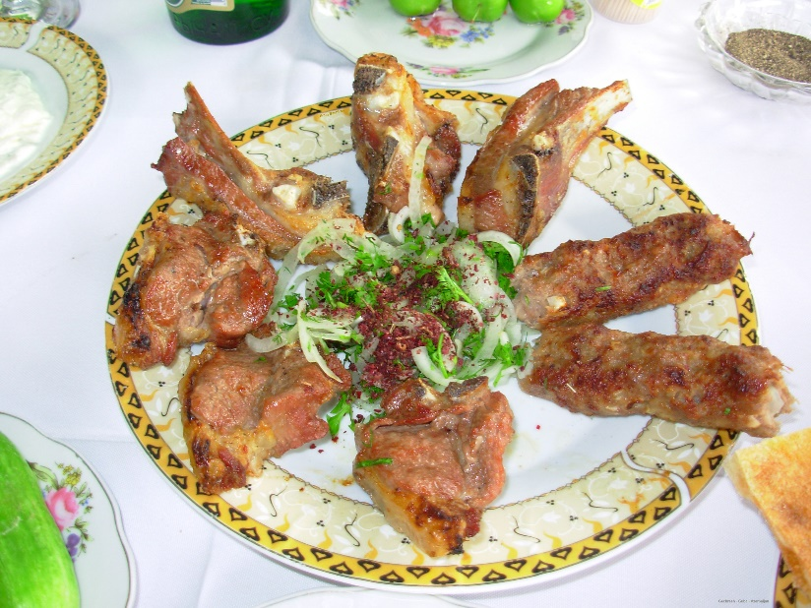

Slide 7
Aa Ee Ii Oo Uu C”u”p p”e”n l”ea”ve “Au”gust f”oo”d

